Slide 1
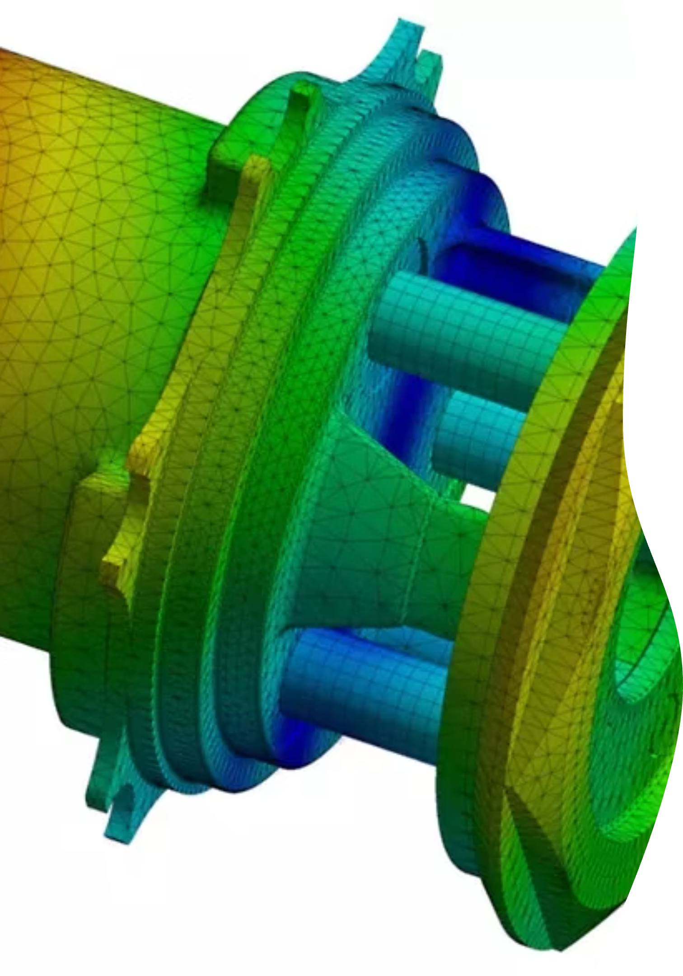
Finite Element Analysis
Final Lab Project: Static and Transient Structural Simulations
Submitted By: Sawera Memon (ME-1887)
This project analyzes a hexagonal beam under:
Static loading
Time-dependent (transient) loading
The analysis was performed using ANSYS

Slide 2
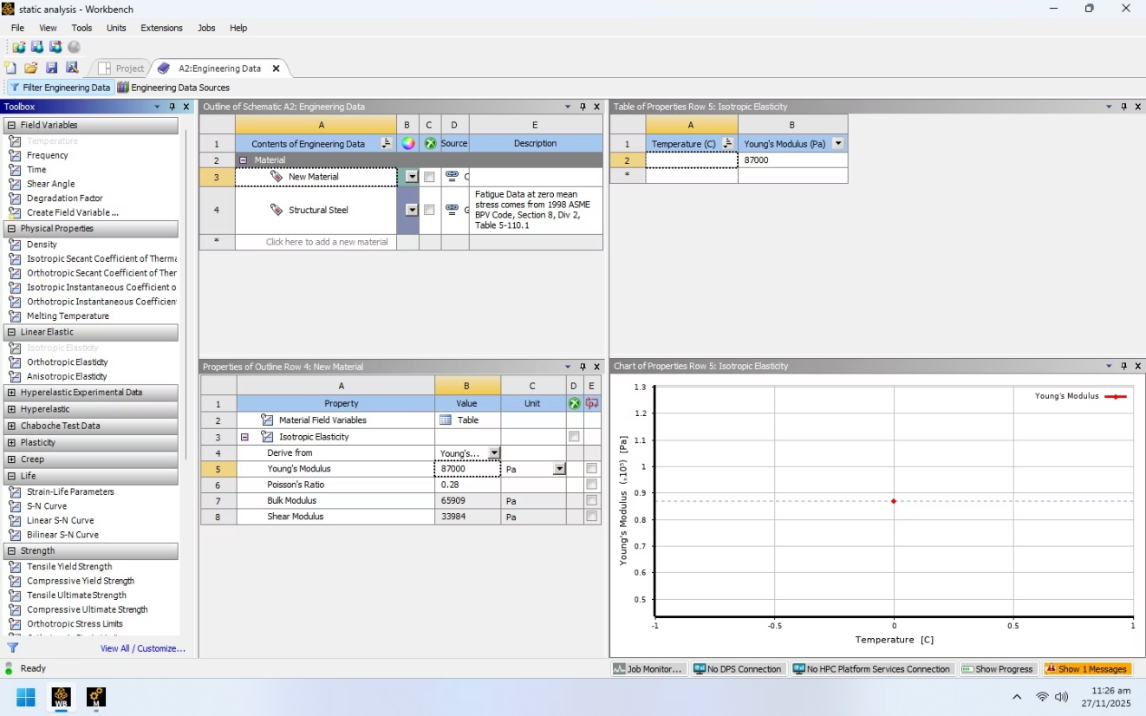
FINAL LAB PROJECT
Static Structural Analysis Setup
Our journey into FEA begins with the fundamental static structural analysis. This phase is crucial for understanding how materials behave under constant loads.
Initiating the Analysis
The project commenced with setting up a Static Structural analysis in ANSYS Workbench, laying the groundwork for precise mechanical simulation.
Defining Custom Materials
A critical step involved creating a custom material within Engineering Data. Material modeled as Linear Elastic and Isotropic.
Properties defined:
Young’s Modulus
Poisson’s Ratio
Assumes elastic behavior within operating stress limits.

Slide 3
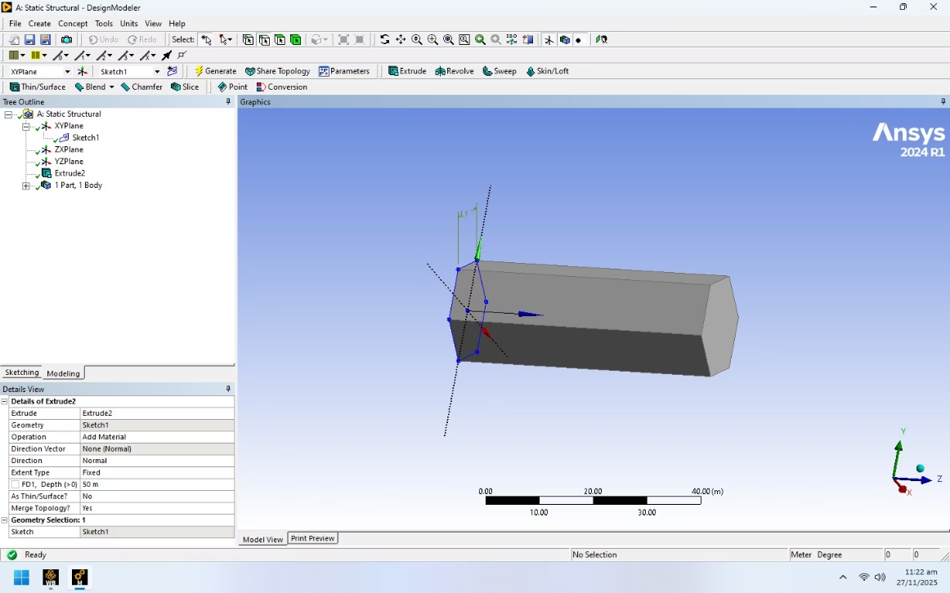
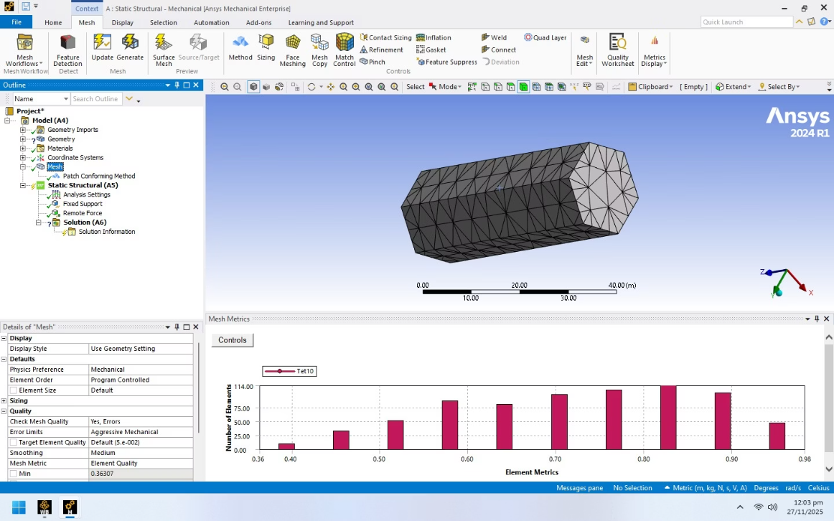
FINAL LAB PROJECT
Geometry Creation & Model Setup
Geometry Sketching and Extrusion
Material Assignment and Meshing
Geometry created using a regular hexagonal cross-section.
Post-extrusion, the custom material was assigned
Sketch plane: XY-plane.
Tetrahedral elements used for meshing.
Beam length: 50 m.
Selected due to:
3D solid model generated by extrusion.
Suitability for polygonal geometries
Ability to capture stress concentration accurately
Mesh quality parameters checked for reliability.

Slide 4
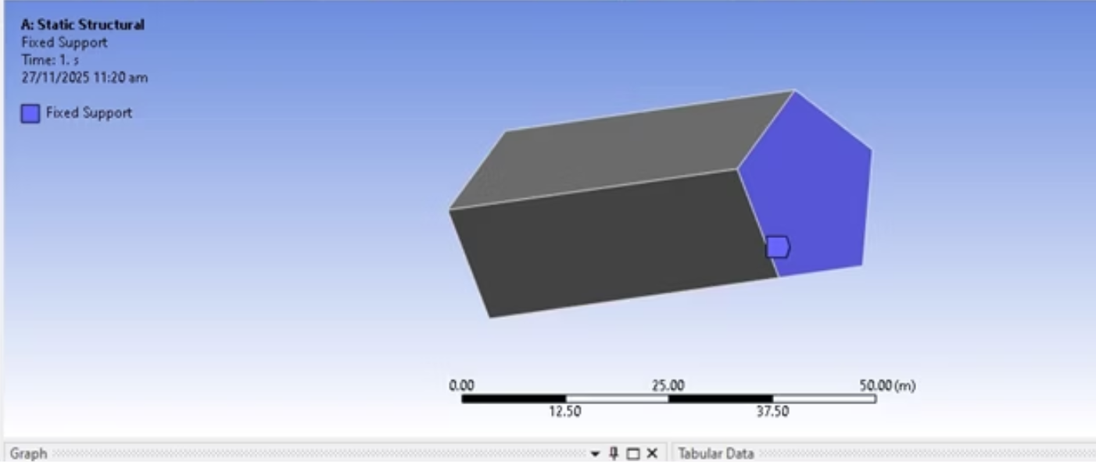
FINAL LAB PROJECT
Boundary Conditions and Loading
Accurate definition of boundary conditions and load application is paramount for realistic simulation outcomes in FEA.
Fixed Support Application
Remote Force Application
One end of the pentagonal beam was subjected to a Fixed Support, constraining all degrees of freedom and simulating a rigid attachment.
A 20 N remote force was strategically applied at one-third of the beam's length, enabling the simulation of an external load without direct contact.

Slide 5
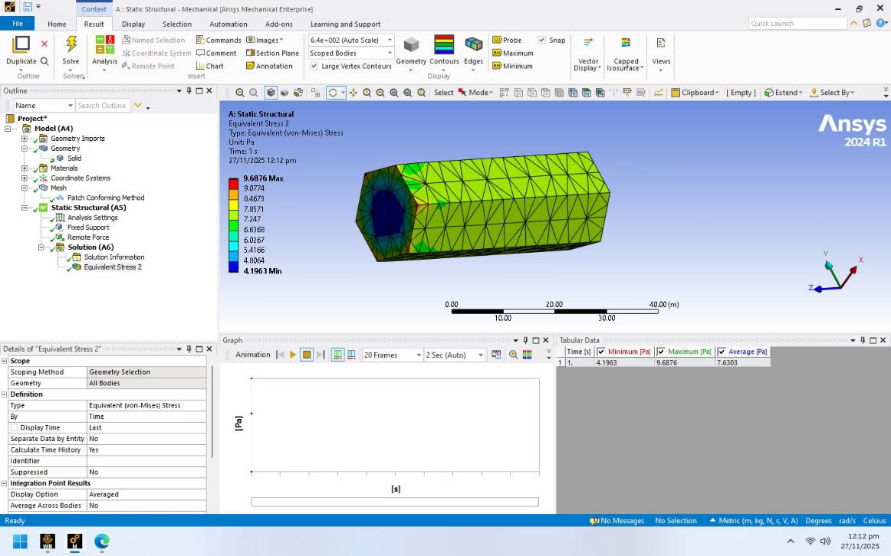
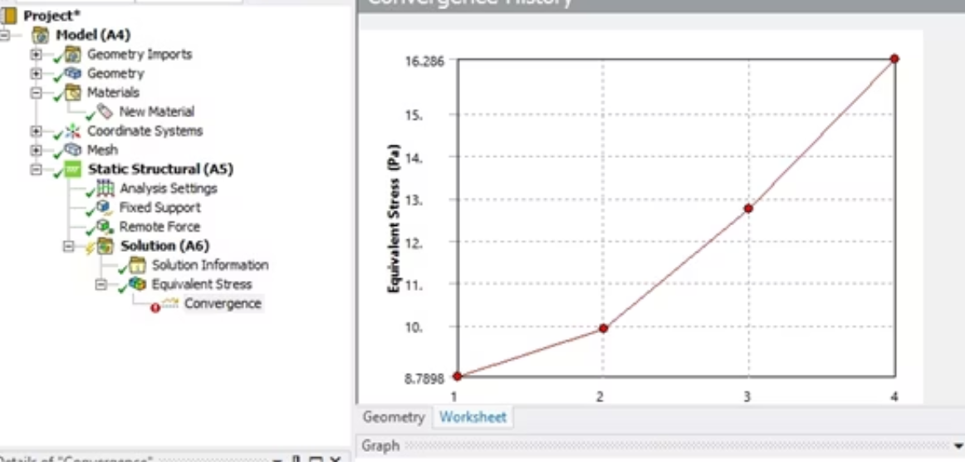
FINAL LAB PROJECT
Stress Evaluation & Mesh Convergence Study
Understanding stress distribution and ensuring result reliability through mesh convergence are vital for validating FEA models.
1
2
Von Mises Stress Analysis
Mesh Convergence Implementation
Von Mises stress used to evaluate stress state.
A comprehensive mesh convergence study was executed, involving 3 refinement loops and targeting a 10% allowable change to guarantee mesh-independent and accurate results.
Maximum stress observed near the fixed support.
Stress decreases toward the free end.
Stress distribution reflects hexagonal geometry.

Slide 6
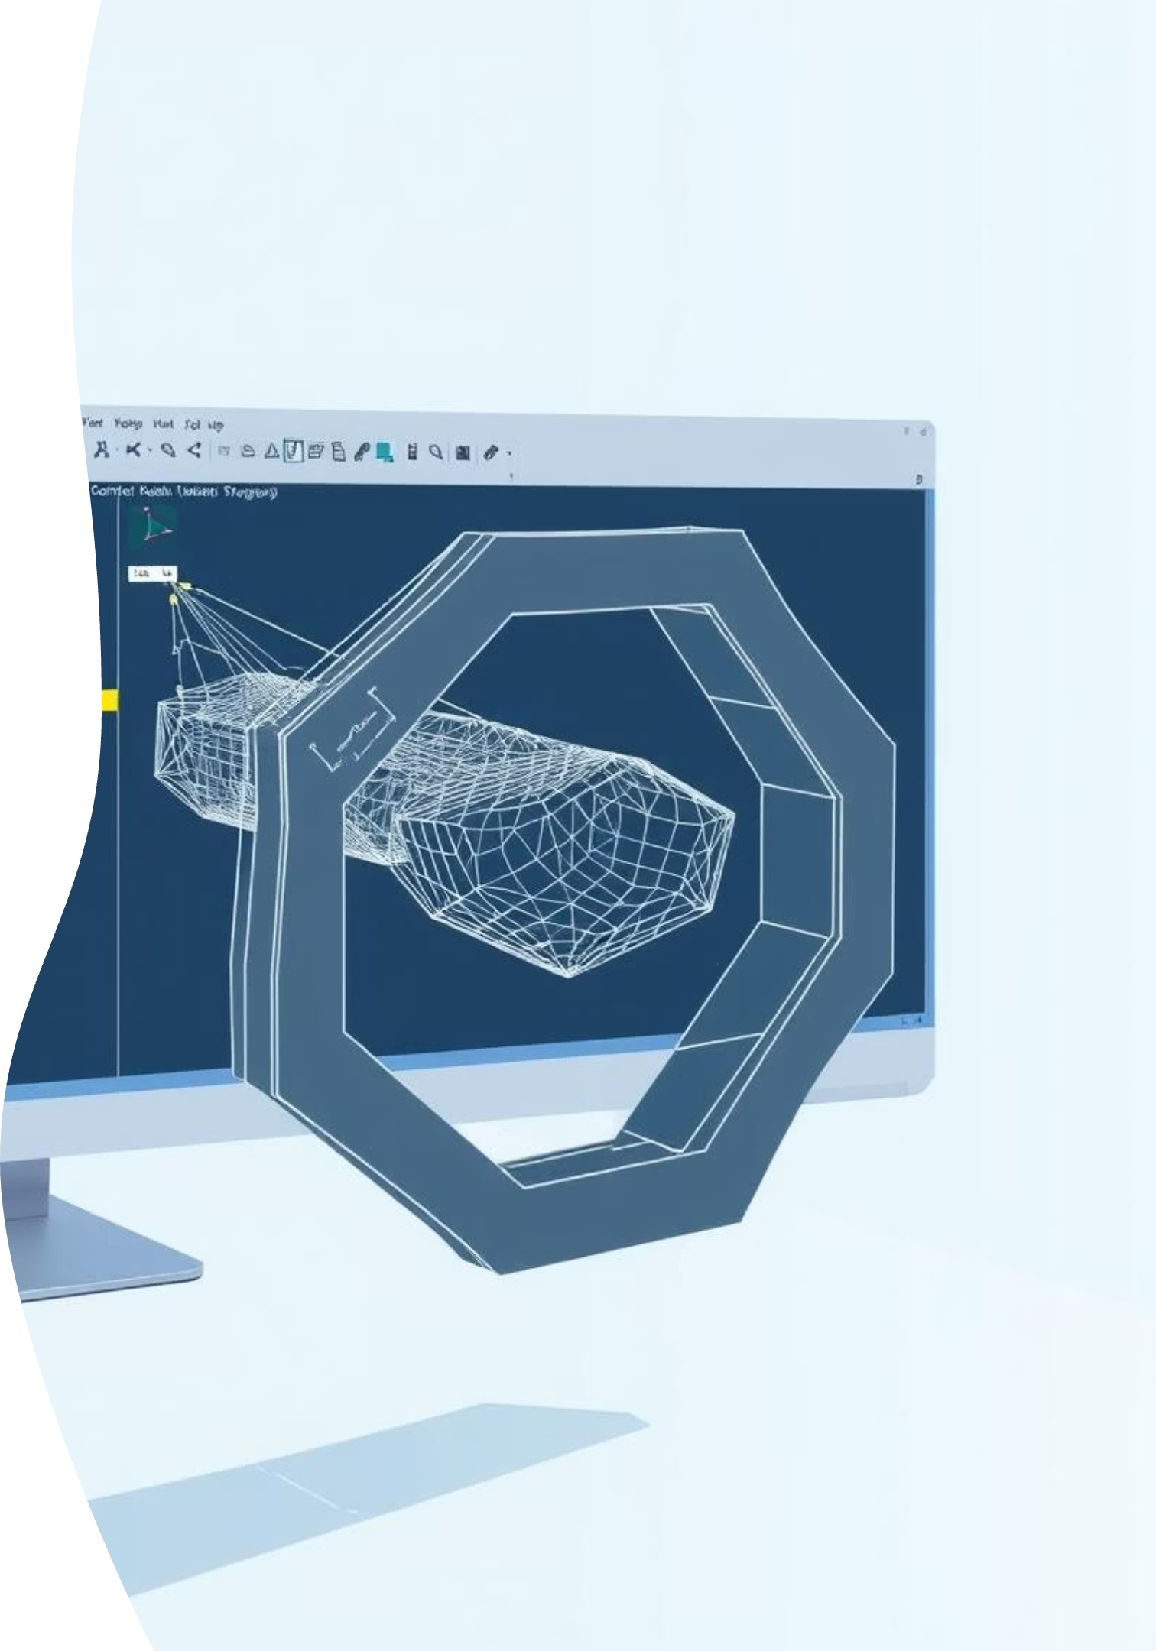
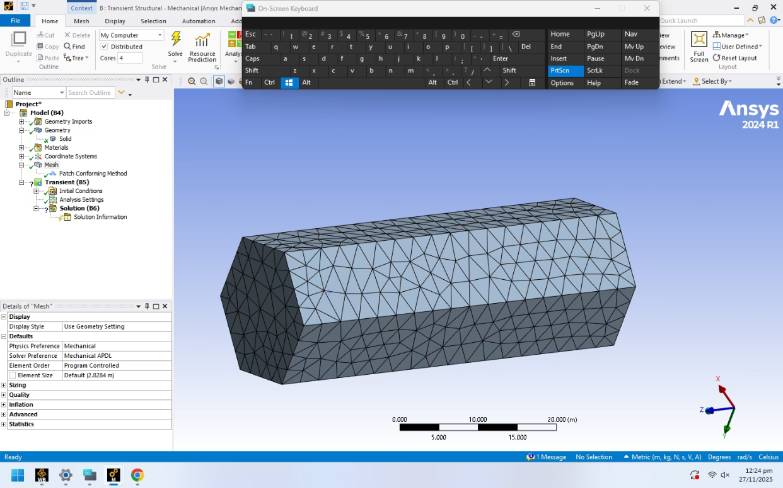
FINAL LAB PROJECT
Implicit Simulation
Moving beyond static conditions, implicit transient structural analysis allows us to observe dynamic responses of materials over time, crucial for understanding real-world performance.
Transient Structural Analysis
The implicit simulation phase initiated with a Transient Structural analysis in ANSYS Workbench, designed to capture time-dependent material behaviors.
Geometry and Mesh Replication
Similar to the static analysis, a pentagon was sketched on the XY-plane and extruded 50m in DesignModeler. A tetrahedral mesh was then applied and verified for quality, ensuring consistency across simulations.

Slide 7
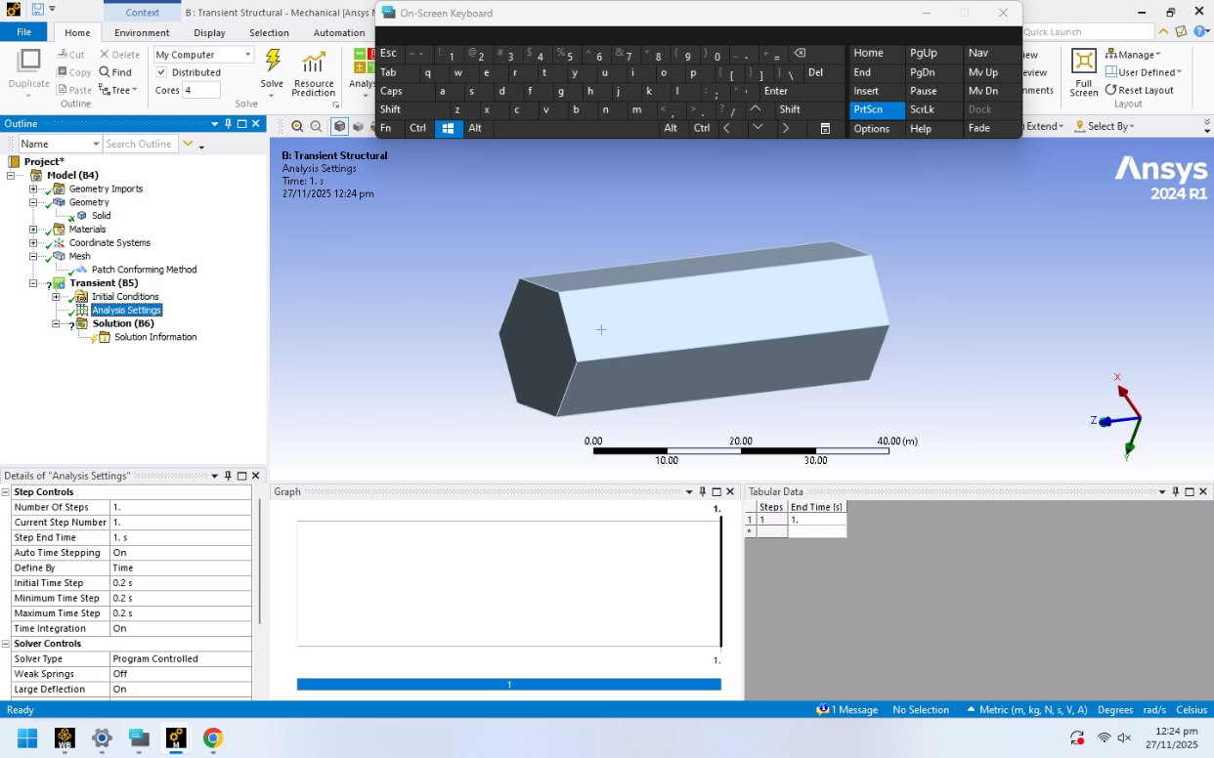
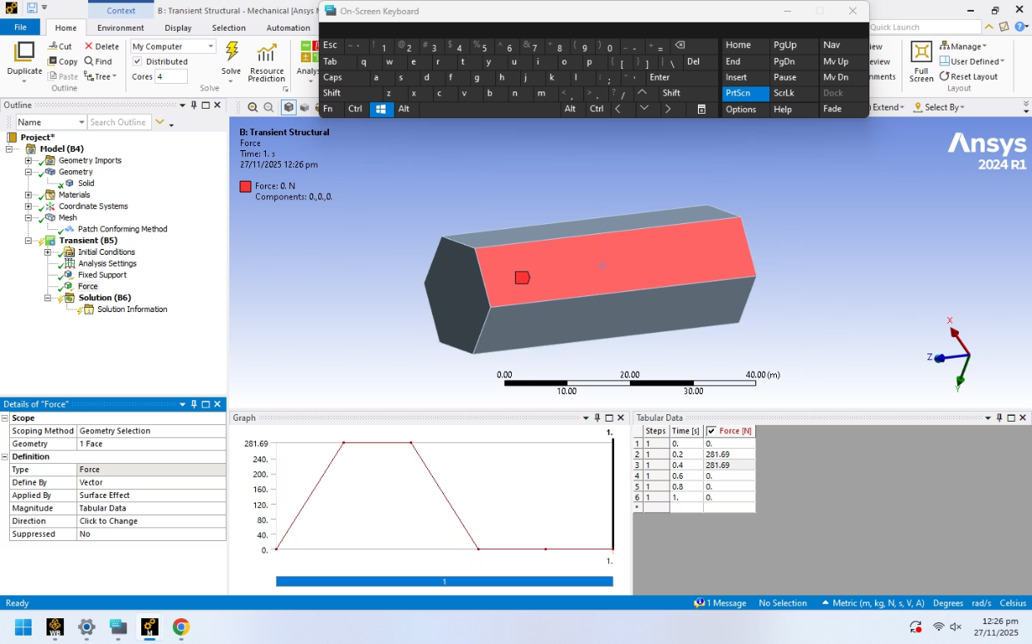
FINAL LAB PROJECT
Boundary Conditions and Force Application
For transient simulations, the timing and sequence of force application are critical to accurately model dynamic responses.
01
02
03
Time Step Configuration
Distributed Force Application
Time-Dependent Loading Sequence
The analysis settings were configured with a time step of 0.2 s, allowing for precise capture of dynamic events over the simulation period.
The beam was fixed at one end, and a uniform force of 281.69 N was applied to each face of the pentagon, simulating a distributed load condition.
Forces were applied in a time-dependent manner, with each face loaded sequentially in distinct time intervals: 0.2–0.4 s, 0.4–0.6 s, 0.6–0.8 s, and 0.8–1.0 s, mimicking a dynamic impact or varying load scenario.

Slide 8
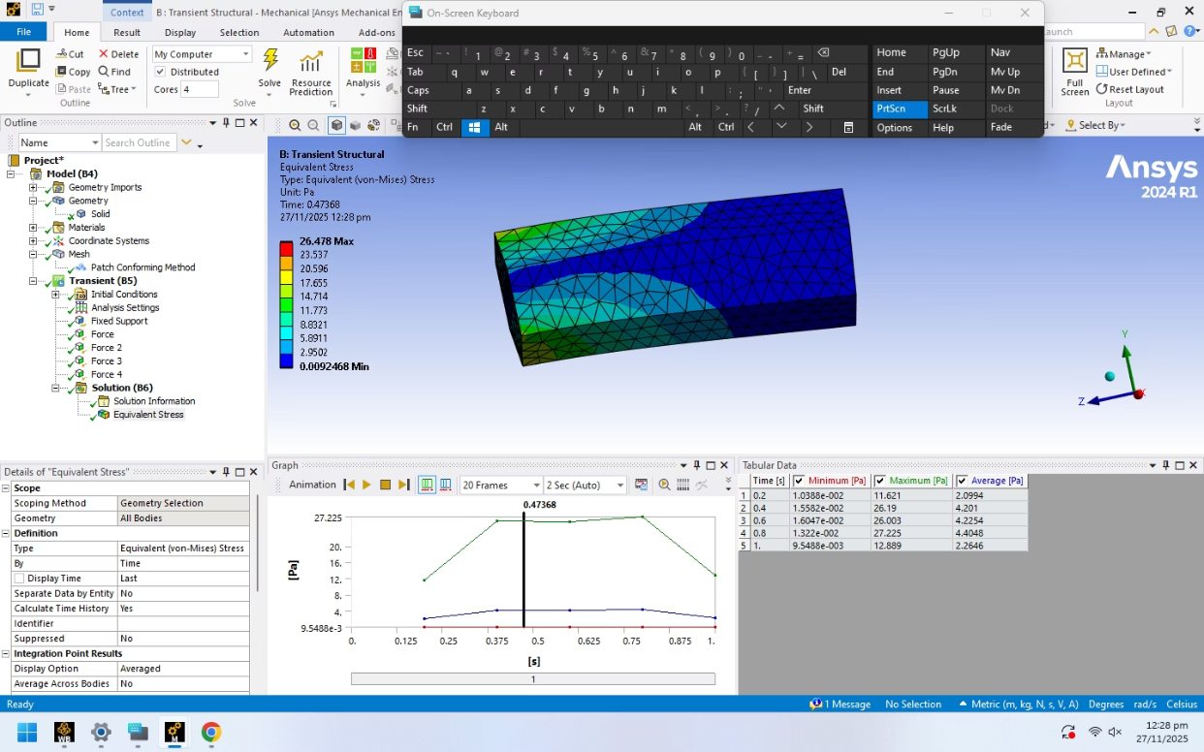
FINAL LAB PROJECT
Result Evaluation: Stress and Deformation
Analyzing the output of the transient simulation provides critical data on the structural response under dynamic conditions.
Interpreting Von Mises Stress
The von Mises stress results were thoroughly examined to identify regions of maximum stress, particularly at the fixed support, indicating areas prone to failure under dynamic loads.
Total Deformation Insights
Concurrently, the total deformation of the beam was evaluated, showing how the structure displaces and changes shape throughout the various loading stages.
Peak Stress Occurrences
Notably, peak stresses were consistently observed during each successive loading stage, with the highest values concentrated at the fixed support, as expected due to boundary conditions.

